Slide 1
Business and Industrial Economics
A.Y. 2023/2024
Prof. Mattia Pedota
Oligopolistic Markets: Classical Duopolistic Models (Bertrand, Cournot and Stackelberg)

Slide 2
Types of oligopolistic models
Models can be:
1. Collusive (e.g. cartel)
2. Competitive: no collusion (Bertrand, Cournot, Stackelberg).
Simultaneous models (Bertrand, Cournot).
Sequential models (Stackelberg).
Key variables:
Prices adopted by each company (Bertrand)
Quantities offered by each company (Cournot, Stackelberg)

Slide 3
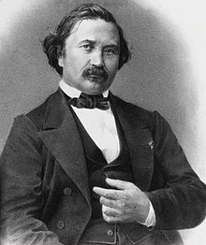
Oligopolistic models: Bertrand model
 | Decision on quantities | Decisions on prices
Sequential decisions | Quantity leadership (Stackelberg) | Price leadership
Simultaneous decisions | Quantity choice (Cournot) | Price choice (Bertrand)
Collusion | Quantity joint decision | Price joint decision
Bertrand
1822-1900

Slide 4
Bertrand model
The Bertrand (1883) model analyzes firms’ behavior under conditions of oligopoly, adopting price as the focal strategic variable
In its simplest form, it is based on the following assumptions:
Only 2 companies: duopolistic competition
No potential entrants (closed markets)
Homogenous good
Perfect rationality
Perfect information
Same cost function (same technology) with MC=AC=c
Only 1 strategic variable: price
Price is decided simultaneously

Slide 5
Bertrand model
Essentially, two identical, perfectly rational and perfectly informed firms i and j compete by simultaneously choosing price.
→ Consumers, who are also perfectly rational and perfectly informed, demand the good from the company with the lowest price.

Slide 6
Bertrand model
What are the options for firm i? If i sets a price:
Lower than j, it captures the entire market demand
Equal to j, it shares the market demand with j
Greater than j, it has a null market demand (consumers demand the good from j)

Slide 7
Bertrand model
The assumed cost function is:
This way:
Fixed costs are zero:
Average Cost (AC) and Marginal Cost (MC) coincide:
Thus, the profit will be:

Slide 8
Bertrand model
i and j choose their price in order to maximize profits
Under our cost assumptions, profit functions are:
The game is simultaneous and competitive (each company tries to maximize its own profit)

Slide 9
Bertrand model - equilibrium
Nash equilibrium:
Couple of strategies where none of the players find it convenient to change strategy given the other’s strategy
No one can unilaterally change its position and improve its situation
→ Each company’s price maximizes profits given the other’s choice
- Nash equilibrium

Slide 10
Bertrand model - equilibrium
It is easy to demonstrate that in the Nash equilibrium each firm chooses a price equal to c:
In this case, none of the two companies has an incentive to change its choice, given the other’s choice.
Price higher than c: loss of the entire demand
Price lower than c: the firms makes losses instead of profits
Given the market conditions, firms are identical and the game is symmetric; the reasoning developed for one player is perfectly applicable to the other

Slide 11
Bertrand model - equilibrium
Let’s check why needs to hold.
There are three possible alternatives:
Case I
Case II
Case III
( can’t be < c because c=MC=AC)

Slide 12
Bertrand model - equilibrium
As long as either of the two firms sets a price higher than c, there is no equilibrium. The firm setting p > c always has an incentive to lower the price to the point it is infinitesimally lower than the price charged by the other firm, in order to capture the whole demand.
→ Each firm has always the incentive to revise its price decision, unless the price for both firms is equal to c=MC=AC

Slide 13
Bertrand model - equilibrium
Thus, the Nash equilibrium is represented by the following couple of strategies:

Slide 14
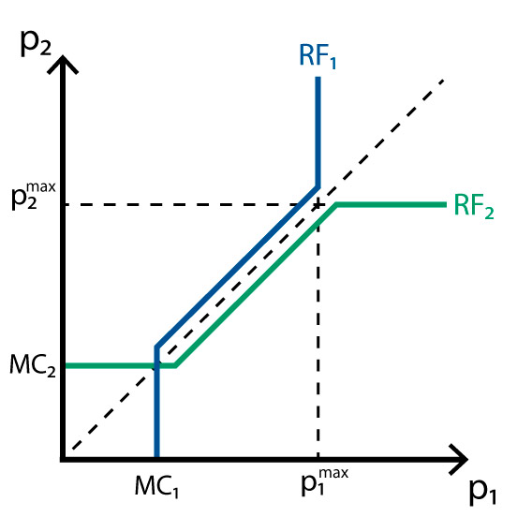
Bertrand model - equilibrium

Slide 15
Bertrand model - critique
In reality, most industries with only two competitors seem to make extra profits.
Why?

Slide 16
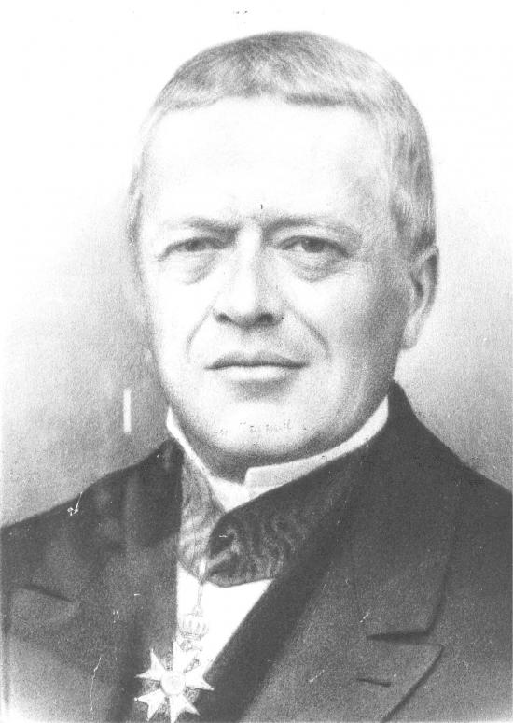
Oligopolistic models
 | Decision on quantities | Decisions on prices
Sequential decisions | Quantity leadership (Stackelberg) | Price leadership
Simultaneous decisions | Quantity choice (Cournot) | Price choice (Bertrand)
Collusion | Quantity joint decision | Price joint decision
Cournot
1801-1877

Slide 17
Cournot model
Developed in 1838 by French philosopher, mathematician and economist Antoine Augustin Cournot
Cournot duopoly assumptions:
Only 2 firms
No potential entrants (closed markets)
Homogenous good
Perfect rationality
Perfect information
Only 1 strategic variable: quantity (q)
Production levels are simultaneously decided
The price is determined by the market at a level where the demand equals the joint production of the two firms

Slide 18
Cournot model
The strategic variable is quantity:
Firms choose how much they want to produce, and the price is given by the aggregated market demand (under the hypothesis of standard goods, the DD has a negative slope):
1°
Quantity
2°
Prices
Remark:

Slide 19
Cournot model - equilibrium
The two firms strategically interact by influencing the (unique) market price through the quantity they set
Equilibrium: given the competitor’s choice, firms choose the best strategy to maximize their profits
Assume that:
Firms can choose the quantity they prefer in the interval
Both the profit functions can be differentiated in quantity

Slide 20
Cournot model - equilibrium
Goal: derive the equilibrium (2 steps):
Determine the set of optimal choices of each firm given the rival’s behavior → determine reaction functions
Intersect the two reaction functions in order to find the combination of mutually compatible decisions (i.e., the Nash-Cournot equilibrium of the game)

Slide 21
Cournot model – equilibrium Graphical derivation of the equilibrium (intersection)
q₂
q₁(q₂)
Q produced in perfect competition
q₂ (q₁)
•
Q produced in monopoly
q₁

Slide 22
Cournot model – equilibrium - algebraic derivation
Given the following inverse demand function:
Where Q is the total industry output, equal to:
And the following (assumed) cost functions:

Slide 23
Cournot model – equilibrium - algebraic derivation
Firm 1’s profit is:
The first order condition for a maximum is:
Or simply:
Firm 1’s reaction function

Slide 24
Cournot model – equilibrium – algebraic derivation
By simmetry, Firm 2’s reaction function can be found immediately:
The equilibrium is given by the couple of values
In order to identify the equilibrium, Firm 1 decides its output on the basis of its conjecture regarding Firm 2’s behavior; if Firm 1 expects that Firm 2 will produce the quantity then Firm 1 will have to produce
- Equilibrium values
- Expected values

Slide 25
Cournot model – equilibrium – algebraic derivation
Thus, the Nash equilibrium is the solution to the following system:

Slide 26
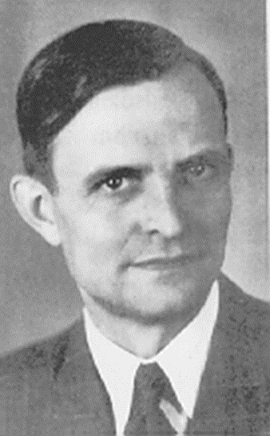
Oligopolistic models and game theory
 | Decision on quantities | Decisions on prices
Sequential decisions | Quantity leadership (Stackelberg) | Price leadership
Simultaneous decisions | Quantity choice (Cournot) | Price choice (Bertrand)
Collusion | Quantity joint decision | Price joint decision
Stackelberg
1905-1946

Slide 27
Sequential models: 2-step competition
Sequential competition: the competition is not simultaneous anymore. Now, it articulates in two steps.
The second step depends on the first one

Slide 28
2-step competition
2-step model solution: backward induction
The second step is contingent on the decisions taken in the first step: the follower maximizes profits given the leader’s choice.
The leader optimizes the first step by maximizing profits given the follower’s reaction in the second step (which is known a priori).
As usual, it is assumed that:
Both the leader and the follower know everything (perfect information)
Both the leader and the follower are perfectly rational

Slide 29
Stackelberg model
The leader considers the (future) follower’s choice when it chooses its own output level
Its profit maximization depends on

Slide 30






Stackelberg model
Algebraically:
Follower’s RF
$$\frac{∂π_{1}}{∂q_{1}}=0→$$

Slide 31
Other strategic variables
In the real world, firms’ strategic behaviors depend on several variables:
Price (Bertrand model)
Quantity (Cournot and Stackelberg models)
R&D investments; Product features; Commercialization modes
…
All these decisions imply strategic interaction and interdependence

Slide 32
Exercise
The market for virtual reality devices has just emerged, and Zorn and Thorn are the only two companies competing in it, according to a classical Cournot duopoly. The market is characterized by the following inverse demand function: P = 200 – 3Q, where Q denotes the total quantity produced in the market. Each firm faces total costs equal to 20 multiplied by the quantity it decides to produce (TC = 20qi for both firms). Determine equilibrium quantity and price.
Suppose that Thorn has an advantage that allows it to enter the market before Zorn does. In this case, the competition would take place according to the Stackelberg paradigm with Thorn as the leader, everything else being equal to point c. However, Zorn has the possibility to employ a team of top-notch big data analysts that would allow it to overcome Thorn’s advantage. In this case, the competition would take place according to the Stackelberg paradigm with Zorn as the leader, everything else being equal to point c. Assume perfect rationality and perfect information on everything. No extraneous factors exist besides those strictly mentioned in the exercise. What is the maximum price that Zorn is willing to pay for the big data analysis?

Slide 33
Solution (first point)
Denote Zorn with 1 and Thorn with 2.
P = 200 – 3Q
TC = 20qi
Π1 = q1 (200 – 3q1 – 3q2 ) – 20q1.
Π1 maximization → 200 – 6q1 – 3q2 – 20 = 0 → q1 = 30 – 0.5q2 (Zorn’s reaction function).
By symmetry, q2 = 30 – 0.5q1 (Thorn’s reaction function).
Equilibrium requires that q1 = 30 – 0.5(30 – 0.5q1) → q1 = q2 = 20.
Thus, Q = 20 + 20 = 40 and P = 200 – 120 = 80.

Slide 34
Solution (second point)
Denote the leader with 1 and the follower with 2. Reaction functions are equal and already known from the previous point.
Π1 = q1 [200 – 3q1 – 3 (30 – 0.5q1)] – 20q1. Π1 maximization → 200 – 6q1 – 90 + 3q1 – 20 = 0 → q1 = 30 → q2 = 15.
Thus, Q = 30 + 15 = 45 and P = 200 – 3*45 = 65.
Hence, the leader’s profits will be equal to 30 (65 – 20) = 1350.
Conversely, the follower’s profits will be equal to 15 (65 – 20) = 675.
The value that the big data analysis has for Zorn is tantamount to the difference between its profits as a leader and its profits as a follower = 1350 – 675 = 675. Hence, as long as the price for the analysis is lower than 675, Zorn will be willing to pay for it.

Slide 35

Questions?

Slide 36
References
POK: WEEK 5 - Monopoly and Oligopoly > Oligopoly > Types of Oligopolies.
Cabral (I edition) 4.1, 4.2, 4.3, 7, 7.1, 7.3, 7.4
Cabral (II edition) 8.1, 8.2, 8.3
Besanko et al. (Microeconomics) 13

